Slide 1
CIGARETTE
Ecdat package

Slide 2
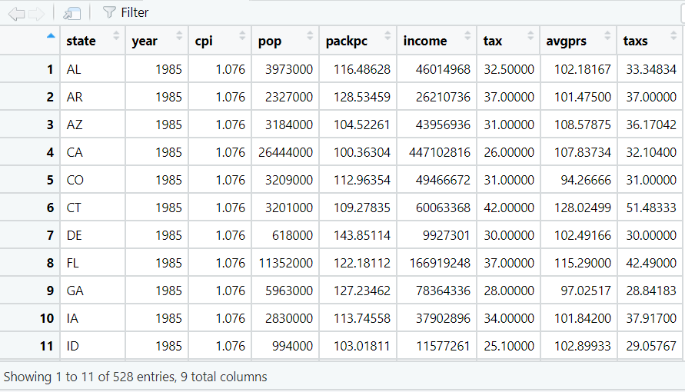
View cigarette data frame
First we need to explore our data, so we use the View() function to clearly see our data frame.
Code:
library(Ecdat)
head(Cigarette)
View(Cigarette)

Slide 3
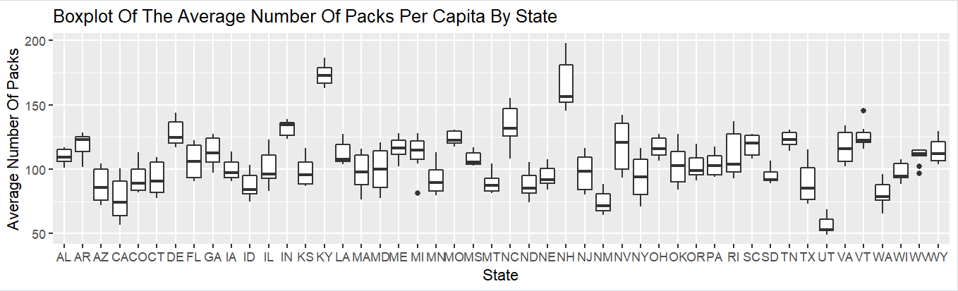
Boxplot of the average number of packs per capita by state

Slide 4
Code:
library(ggplot2)
library(dplyr)
boxplot_pack <- ggplot(Cigarette, aes(x=state, y=packpc)) + geom_boxplot() +
xlab("State") + ylab("Average Number Of Packs") +
ggtitle("Boxplot Of The Average Number Of Packs Per Capita By State")
I can't decide clearly from this plot which state has the highest average number of packs, so to be more accurate, I used this code:
Code:
packpc_state <- Cigarette %>% group_by(state) %>% summarise(mean_pack = mean(packpc)) %>% arrange(desc(mean_pack))
View(packpc_state)
After running this code, KY has the highest average number of packs .
Code:
packpc_state1 <- Cigarette %>% group_by(state) %>% summarise(mean_pack = mean(packpc)) %>% arrange((mean_pack))
View(packpc_state1)
After running this code, UT has the lowest average number of packs.

Slide 5
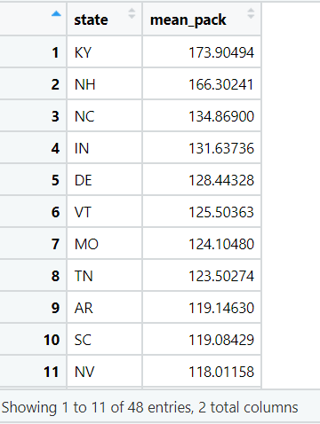
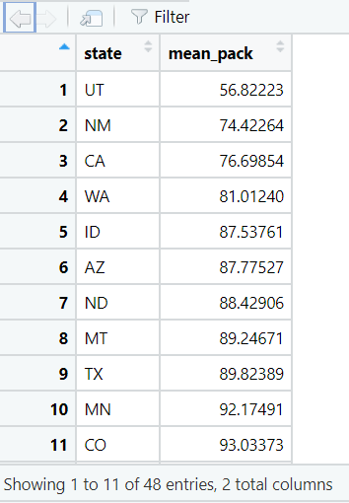
Arrange() Vs arrange(desc())

Slide 6
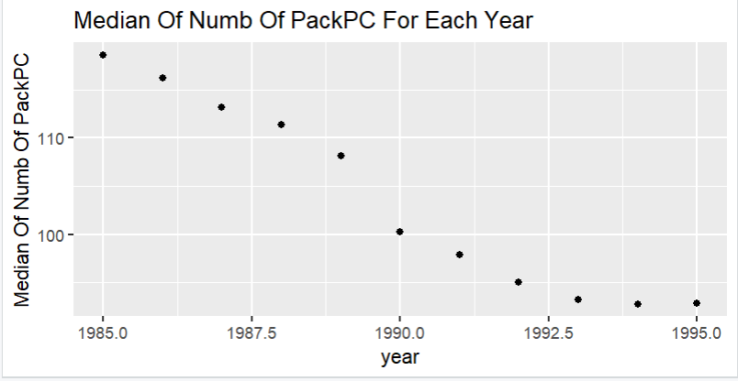
the median over all the states of the number of packs per capita for each year
Code:
unique(Cigarette$year)
med_pack <- Cigarette %>% group_by(year) %>% summarise(medPack = median(packpc))
ggplot(med_pack, aes(x=year, y=medPack)) + geom_point() +ylab("Median Of Numb Of PackPC")+ ggtitle("Median Of Numb Of PackPC For Each Year")
Conclusion: We can notice that the consumption of cigarettes has decreased between 1985 and 1995.

Slide 7
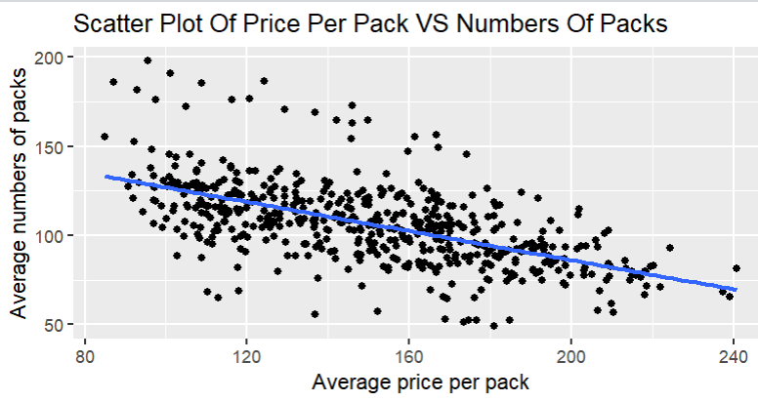
scatter plot of price per pack vs number of packs per capita for all states and years
Code:
ggplot(Cigarette, aes(x=avgprs, y=packpc)) + geom_point() + xlab("Average price per pack") + ylab("Average numbers of packs") +
ggtitle("Scatter Plot Of Price Per Pack VS Numbers Of Packs") +
geom_smooth(method=lm, se=FALSE)
From the scatter plot, we can deduce that the average price and the per capita packs are negatively correlated. This is what we should expect because when the price of a product increases, consumption must decrease.

Slide 8
Calculating correlation
To be more accurate, I used the cor.test function to calculate the correlation.
Code:
cor.test(Cigarette$avgprs, Cigarette$packpc, method = "pearson", use= "complete.obs")
Conclusion:
This is a significant correlation, p-value less than 0.05 and very small, r = -0.58
that's mean there is a moderate correlation and they are negatively correlated.

Slide 9
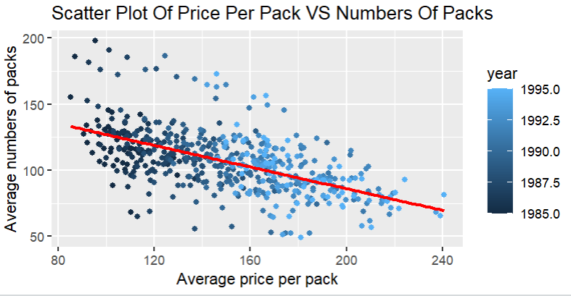
scatter plot showing the points for each year in a different color
Code:
ggplot(Cigarette, aes(x=avgprs, y=packpc, color = year)) + geom_point() +
xlab("Average price per pack") +
ylab("Average numbers of packs") +
ggtitle("Scatter Plot Of Price Per Pack VS Numbers Of Packs") +
geom_smooth(method=lm, se=FALSE, colour = "red")
From this scatter plot, with the addition of years, the relationship between the two variables doesn't change! They are still negatively correlated, so we can assume again that the consumption of cigarettes decreased between 1985 and 1995.

Slide 10
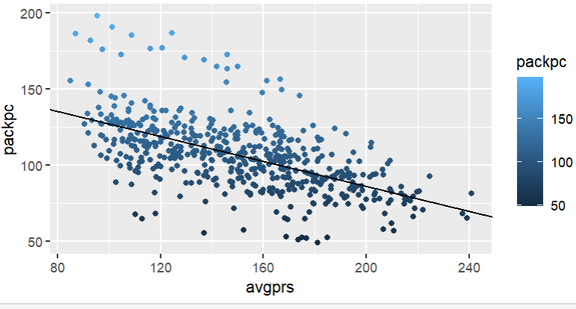
Linear regression for the average price and the average number of packs per capita
Code:
cigarette_regression <- lm(packpc~avgprs, Cigarette)
cigarette_regression
summary(cigarette_regression)
ggplot(Cigarette, aes(x=avgprs, y=packpc, col= packpc)) + geom_point() +
geom_abline(aes(intercept= 167.87, slope = -0.40879))
The line explains 34.15% of the variability of the data; the adjusted R-squared value is 0.3415. This means that the average price is able to explain about 34% of the variance of the average number of packs per capita .

Slide 11
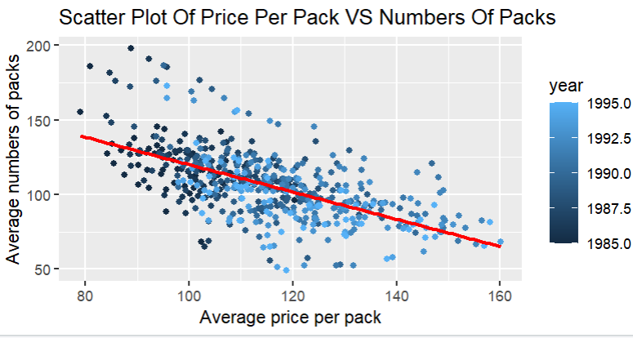
Price adjustment and the new scatter plot
Code:
price_adjust <- Cigarette$avgprs / Cigarette$cpi
adj_cigarette <- cbind(Cigarette, price_adjust)
View(adj_cigarette)
adjust_plot <- ggplot(adj_cigarette, aes(x=price_adjust, y=packpc, color = year)) + geom_point() + xlab("Average price per pack") + ylab("Average numbers of packs") +
ggtitle("Scatter Plot Of Price Per Pack VS Numbers Of Packs") +
geom_smooth(method=lm, se=FALSE, colour = "red")
Conclusion: These two variables are also negatively correlated.
Calculating correlation: cor.test(adj_cigarette$price_adjust, adj_cigarette$packpc, method = "pearson", use= "complete.obs")

Slide 12
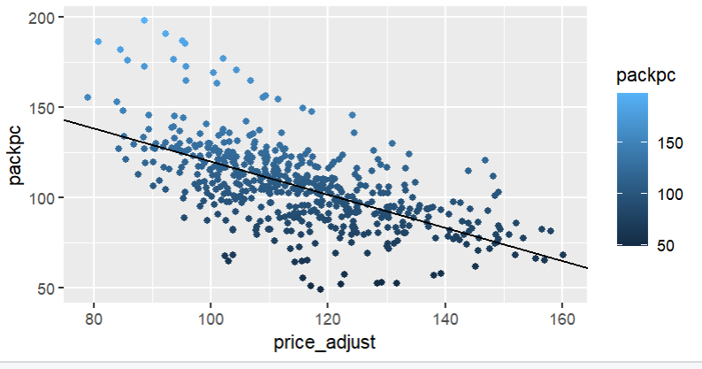
linear regression of price adjustment and pack per capita
Code:
cigarette_regression2 <- lm(packpc~price_adjust, adj_cigarette)
cigarette_regression2
summary(cigarette_regression2)
ggplot(adj_cigarette, aes(x=price_adjust, y=packpc, col= packpc)) + geom_point() + geom_abline(aes(intercept= 211.76821, slope = -0.9164))
After the price adjustment, the line explains 37.57% of the variability of the data; the adjusted R-squared value is 0.3757. This means that the average price is able to explain about 37% of the variance of the average number of packs per capita, 3% more than for the old price.

Slide 13
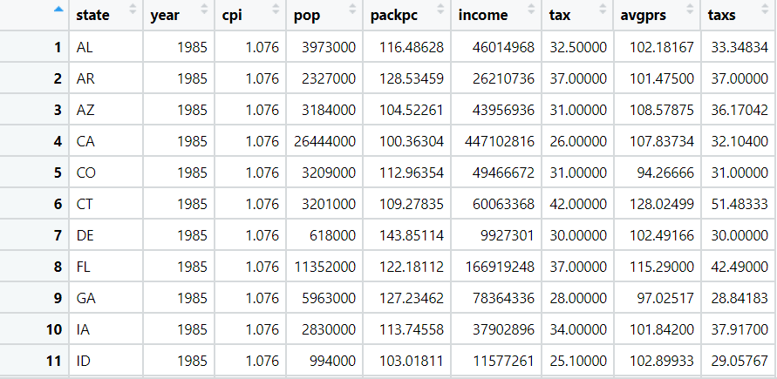
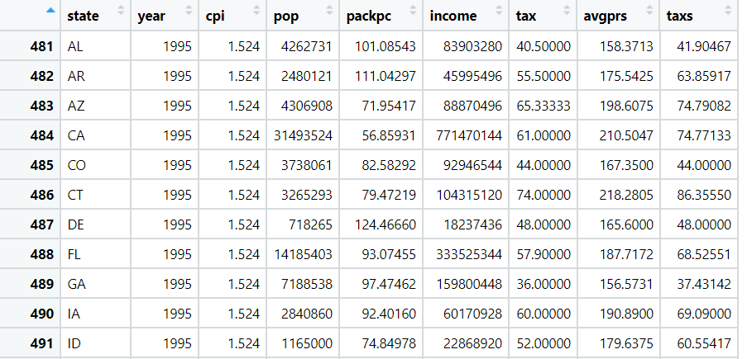
Data frame of 1985 and 1995
Code:
Cigarette_85 <- filter(Cigarette, year == 1985)
View(Cigarette_85)
Code:
Cigarette_95 <- filter(Cigarette, year == 1995)
View(Cigarette_95)

Slide 14
Dependent t-test for the average number of packs in 1985 and in 1995
Code:
t_dep <- t.test(Cigarette_85$packpc, Cigarette_95$packpc, paired = TRUE)
Interpretation:
The number of packs per capita in 1995 was significantly different than the number of packs per capita in 1985; p-value very small and less than 0.05. Also, we have a true difference in means!!

Slide 15
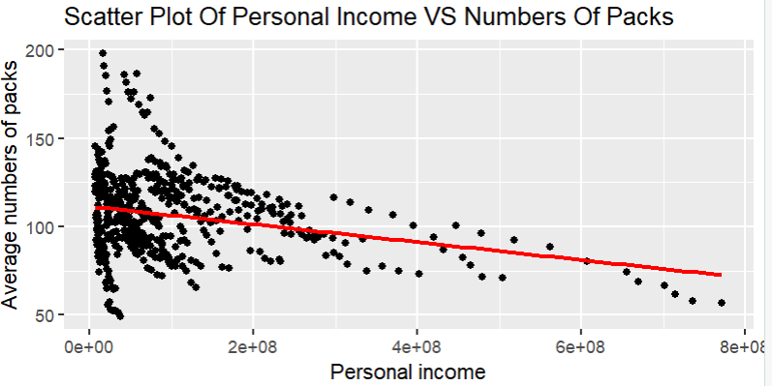
Question 1: are the personal income and the average number of packs correlated?
Code:
ggplot(Cigarette, aes(x=income, y=packpc)) + geom_point() +
xlab("Personal income") + ylab("Average numbers of packs") +
ggtitle"Scatter Plot Of Personal Income VS Numbers Of Packs") +
geom_smooth(method=lm, se=FALSE, colour = "red")
Calculating correlation:
cor.test(Cigarette$income, Cigarette$packpc, method = "pearson", use= "complete.obs")
Conclusion: The plot and the cor.test()results show that the variables income and packpc are uncorrelated or have a weak negative correlation.

Slide 16
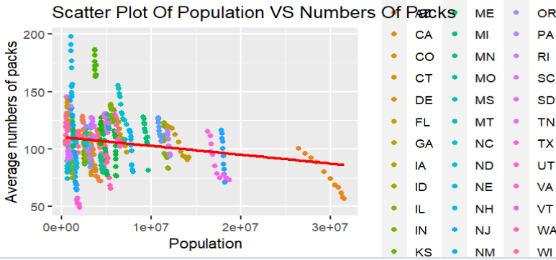
Question 2: Are the population and the average number of packs correlated?
Code:
ggplot(Cigarette, aes(x=pop, y=packpc, color=state)) + geom_point() +
xlab("Population") + ylab("Average numbers of packs") +
ggtitle("Scatter Plot Of Population VS Numbers Of Packs") +
geom_smooth(method=lm, se=FALSE, colour = "red")
Calculating correlation:
cor.test(Cigarette$pop, Cigarette$packpc, method = "pearson", use= "complete.obs")
Conclusion:
We can deduce from the plot and from the cor.test that the two variables, pop and packpc, are uncorrelated or they have a weak negative correlation.

Slide 17
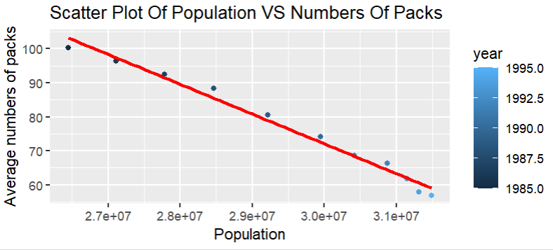
let's see if the population affect the packpc in a specific state (CA) between1985 and 1995
Code:
Cigarette_CA <- filter(Cigarette, state == "CA")
View(Cigarette_CA)
ggplot(Cigarette_CA, aes(x=pop, y=packpc, color=year)) + geom_point() +
xlab("Population") + ylab("Average numbers of packs") +
ggtitle("Scatter Plot Of Population VS Numbers Of Packs") +
geom_smooth(method=lm, se=FALSE, colour = "red")
cor.test(Cigarette_CA$pop, Cigarette_CA$packpc, method = "pearson", use= "complete.obs")

Slide 18
interpretation
We can see clearly that these two variables are strongly negatively correlated. But this is not what I expected! Since the population has increased in CA, the consumption of cigarettes should be higher! But wait, we see above, while exploring the effect of years on the average number of packs per capita , that the consumption of cigarettes decreased between 1985 and 1995, so there is another factor here affecting the decrease of packs, and it's the time because the population increased through the years in CA.

